Slide 1
7-9

Slide 2
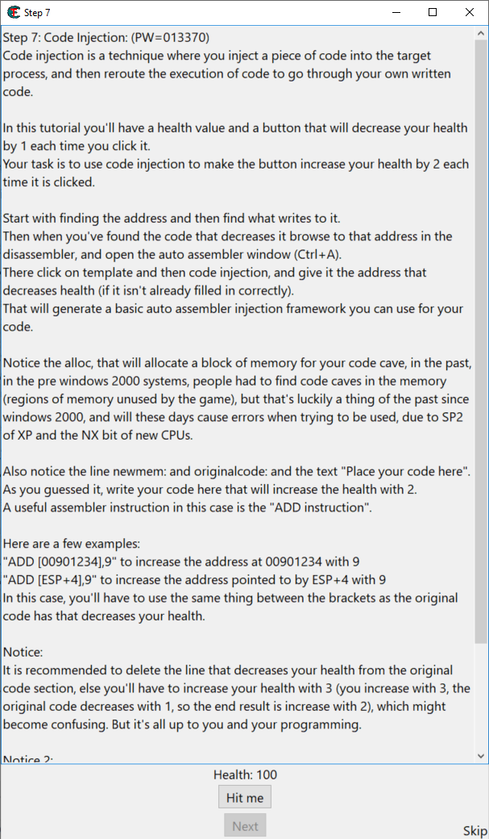
Step 7

Slide 3
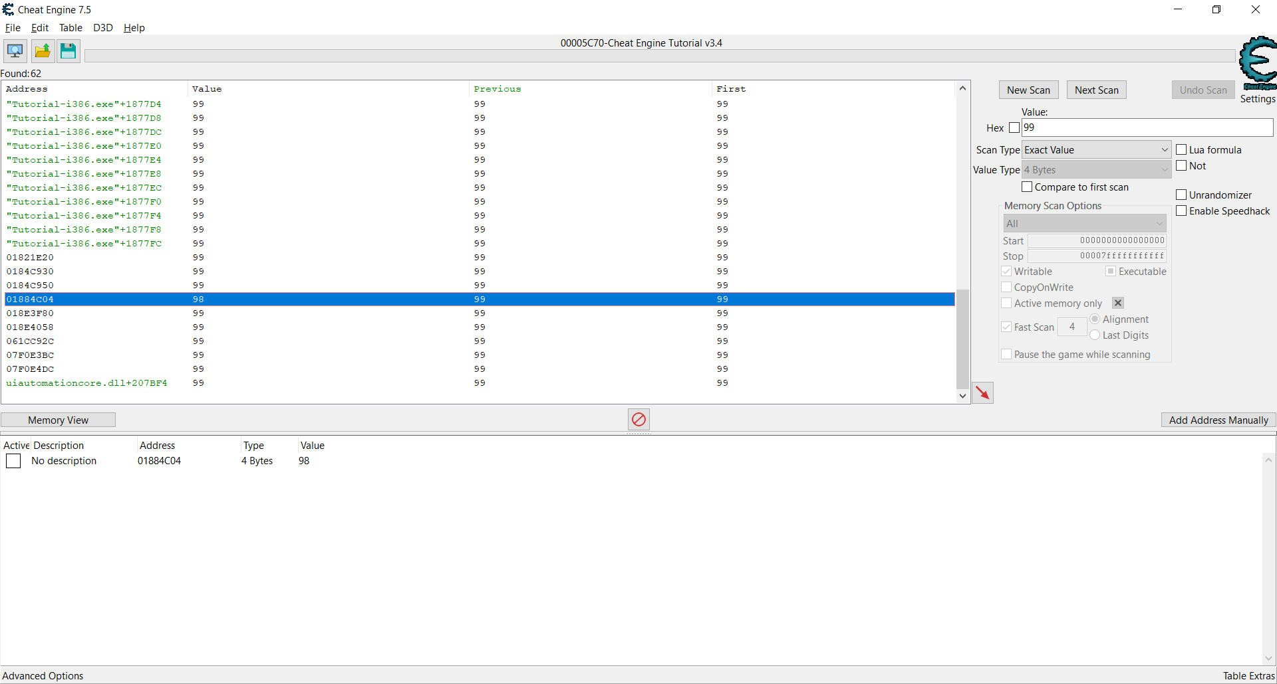

Slide 4
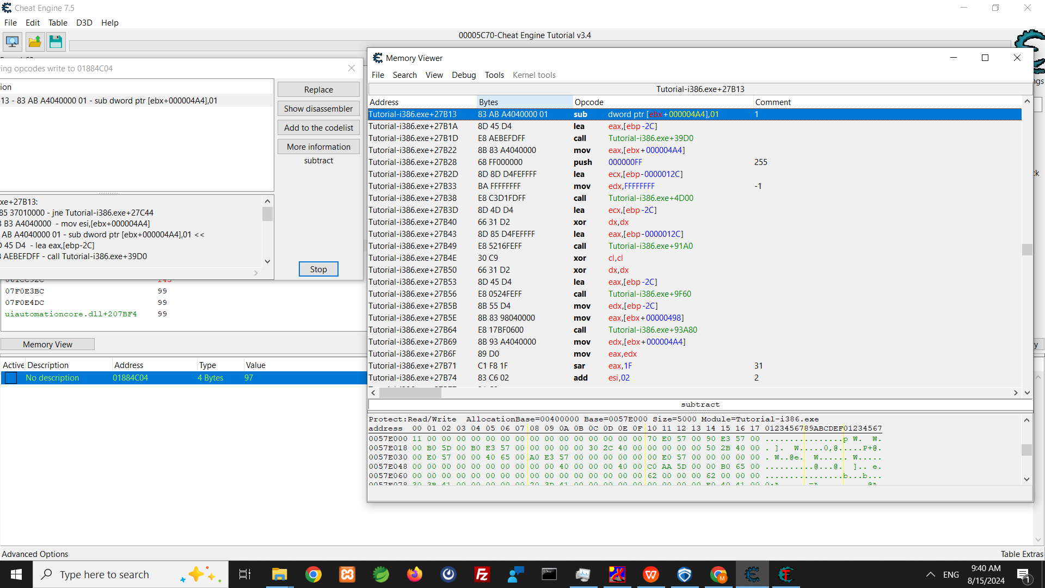

Slide 5
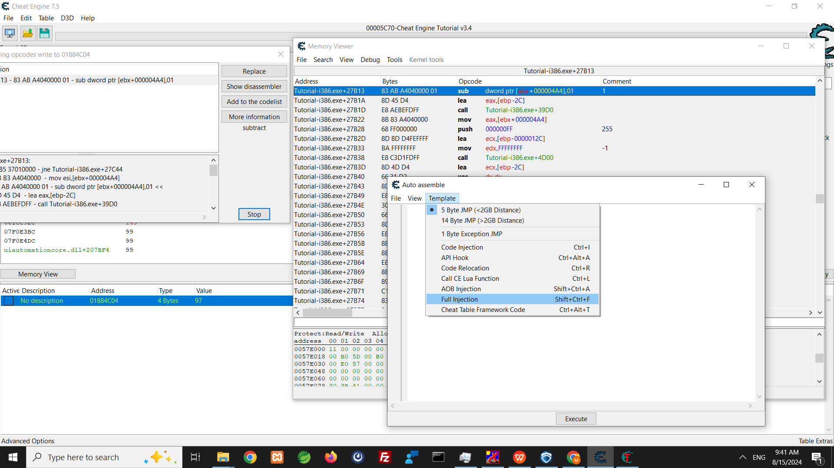

Slide 6
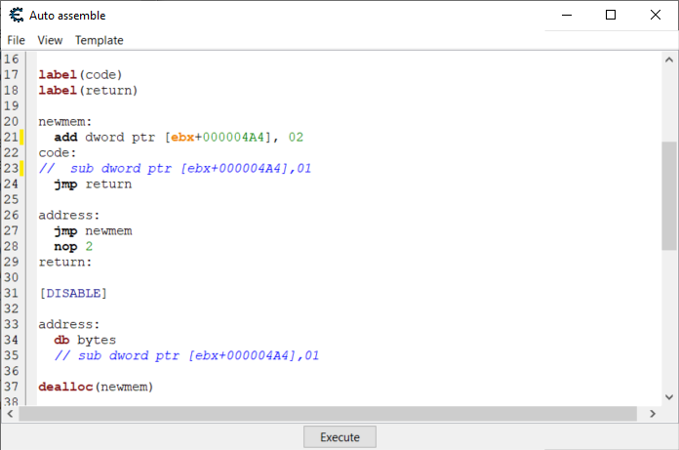

Slide 7
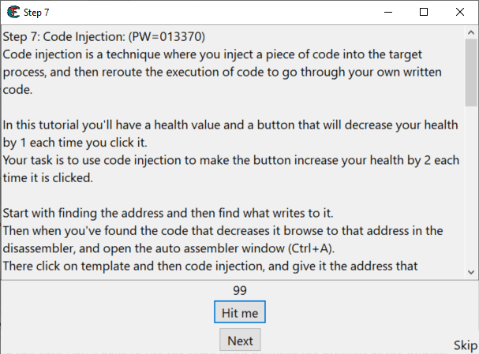

Slide 8
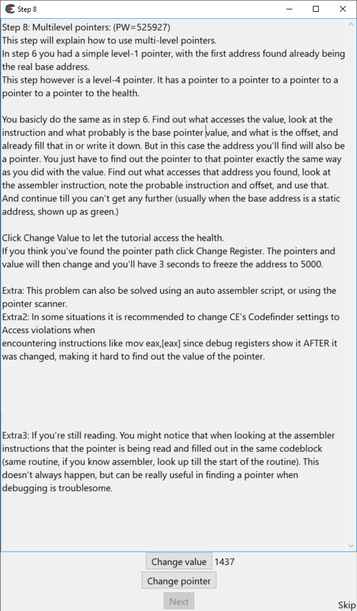
Step 8

Slide 9
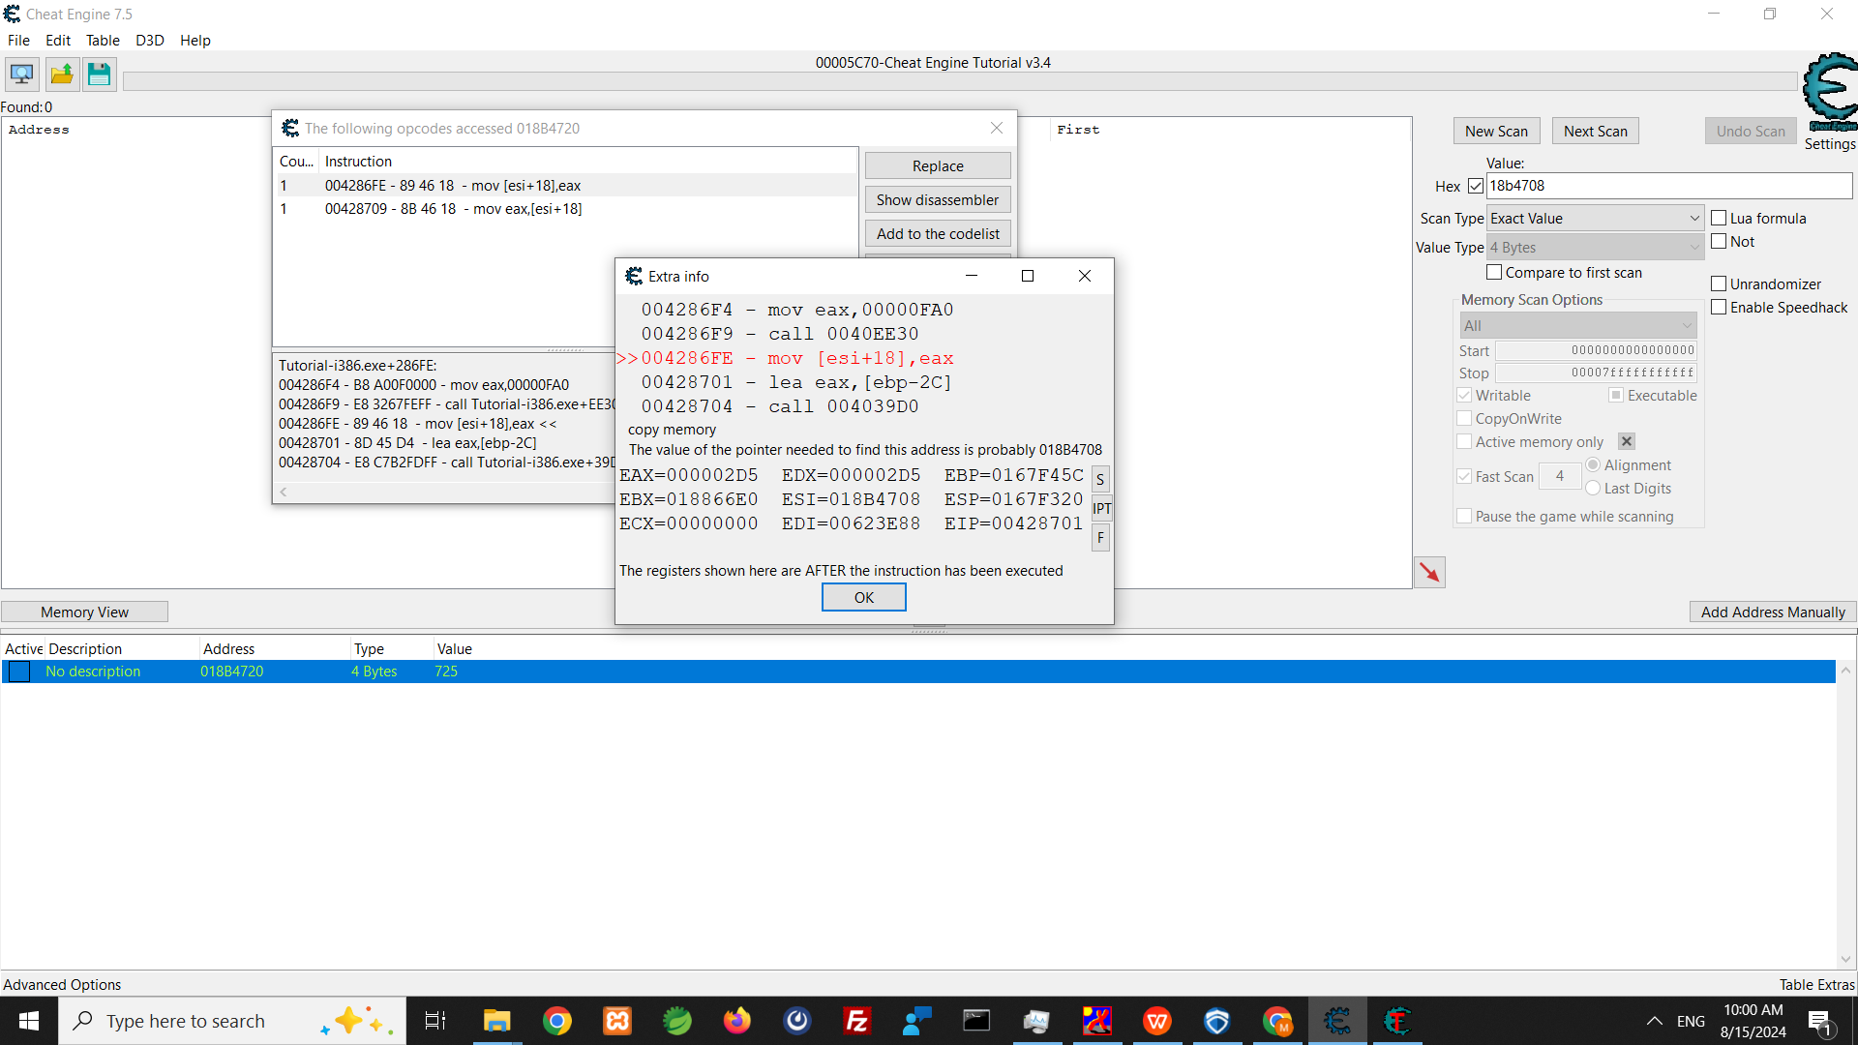

Slide 10
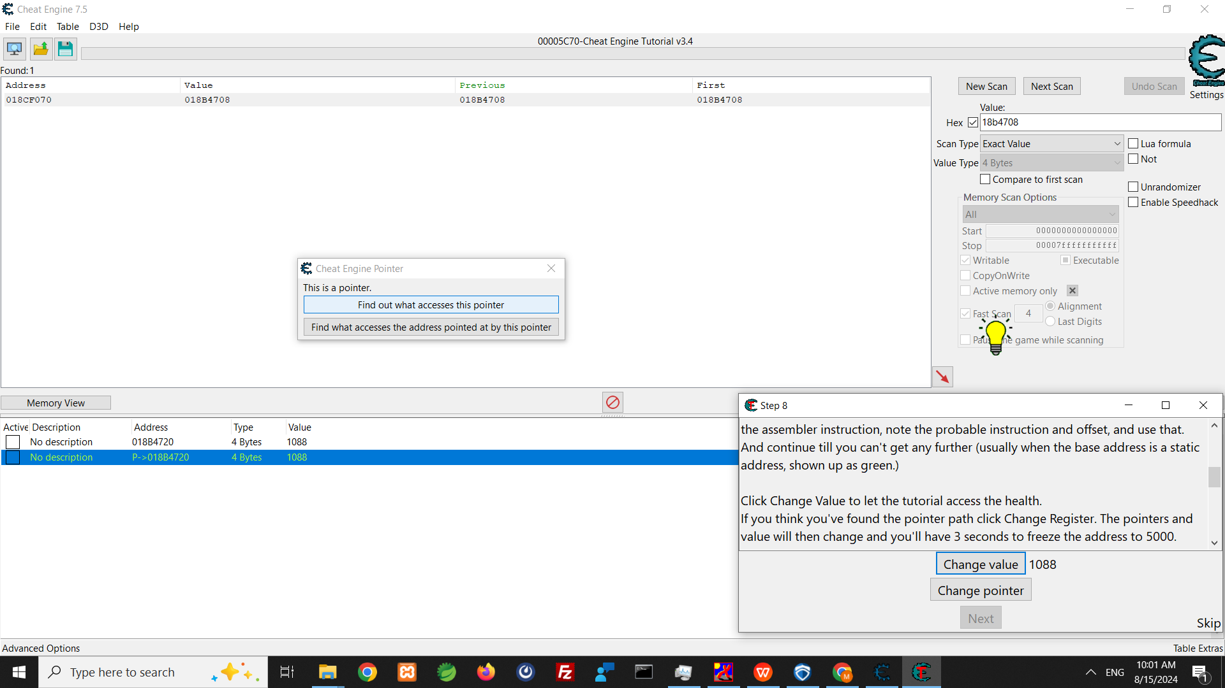

Slide 11
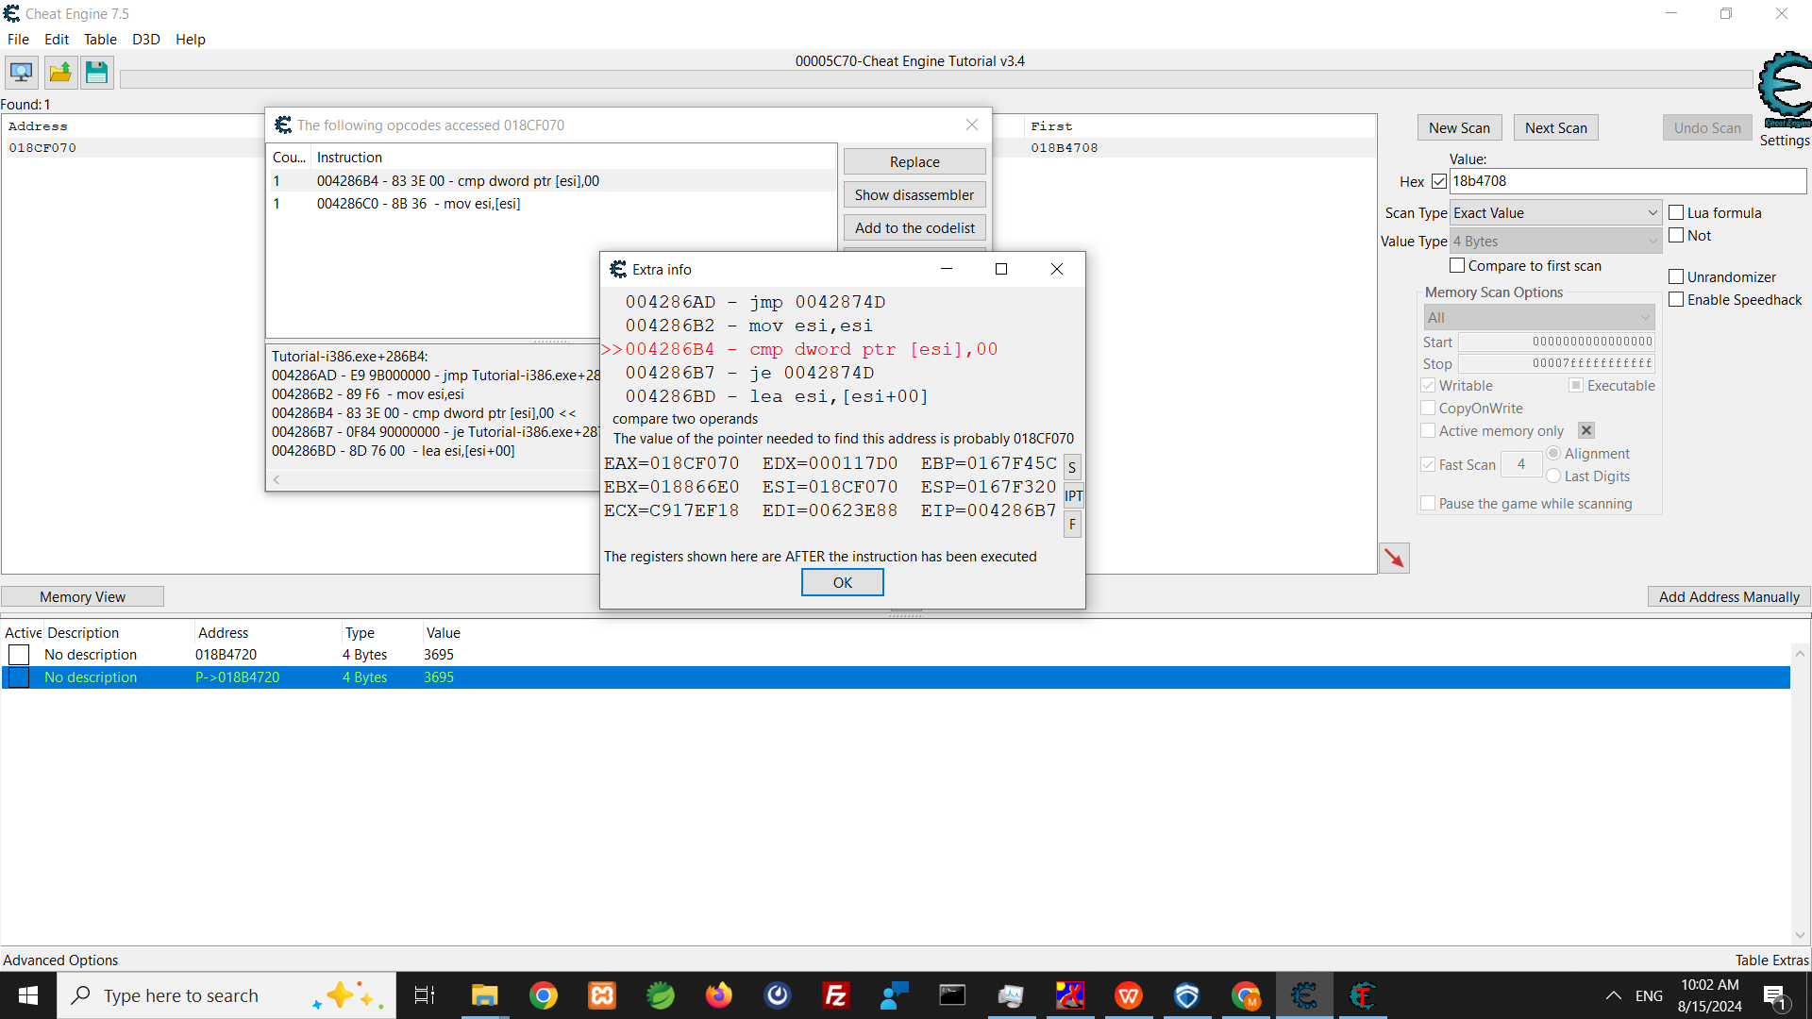

Slide 12
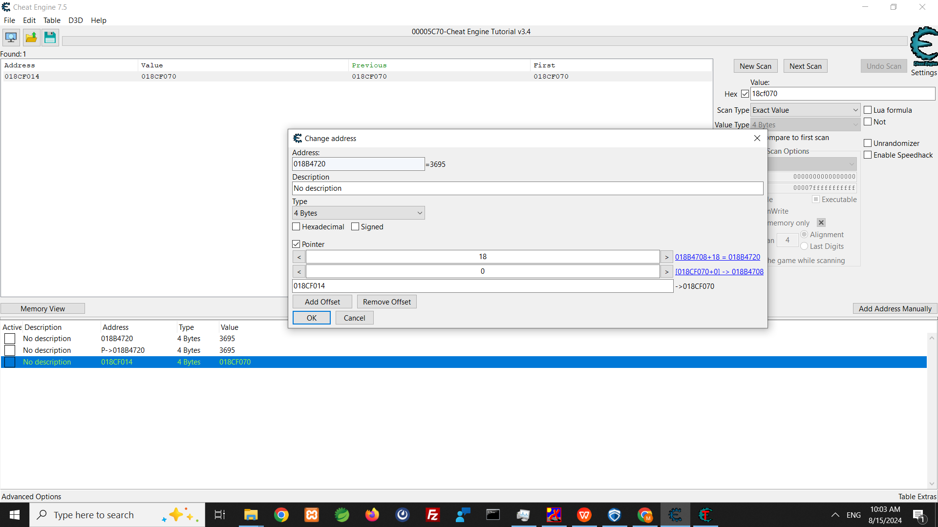

Slide 13
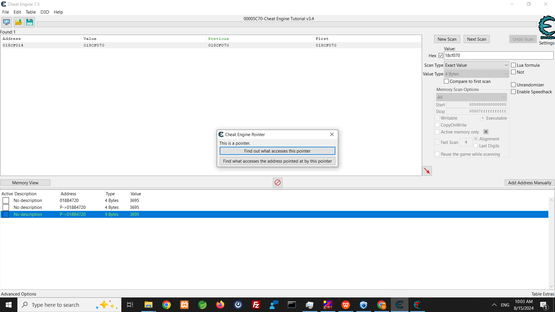

Slide 14
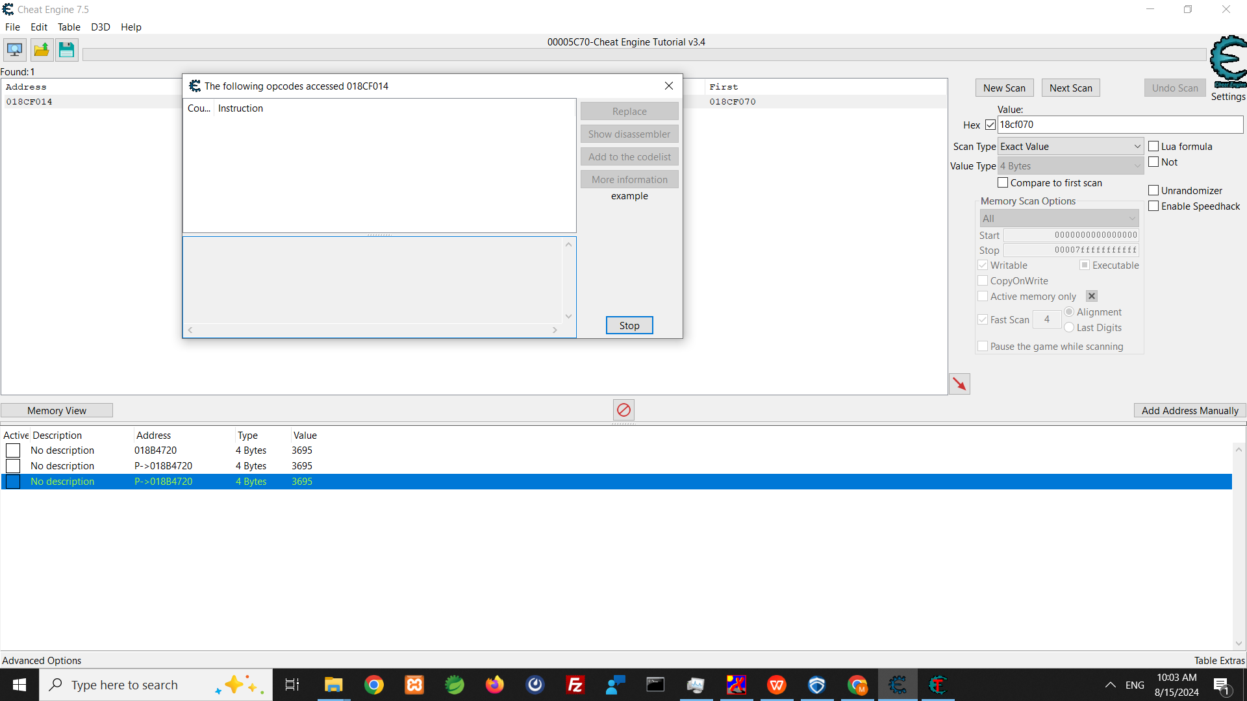

Slide 15
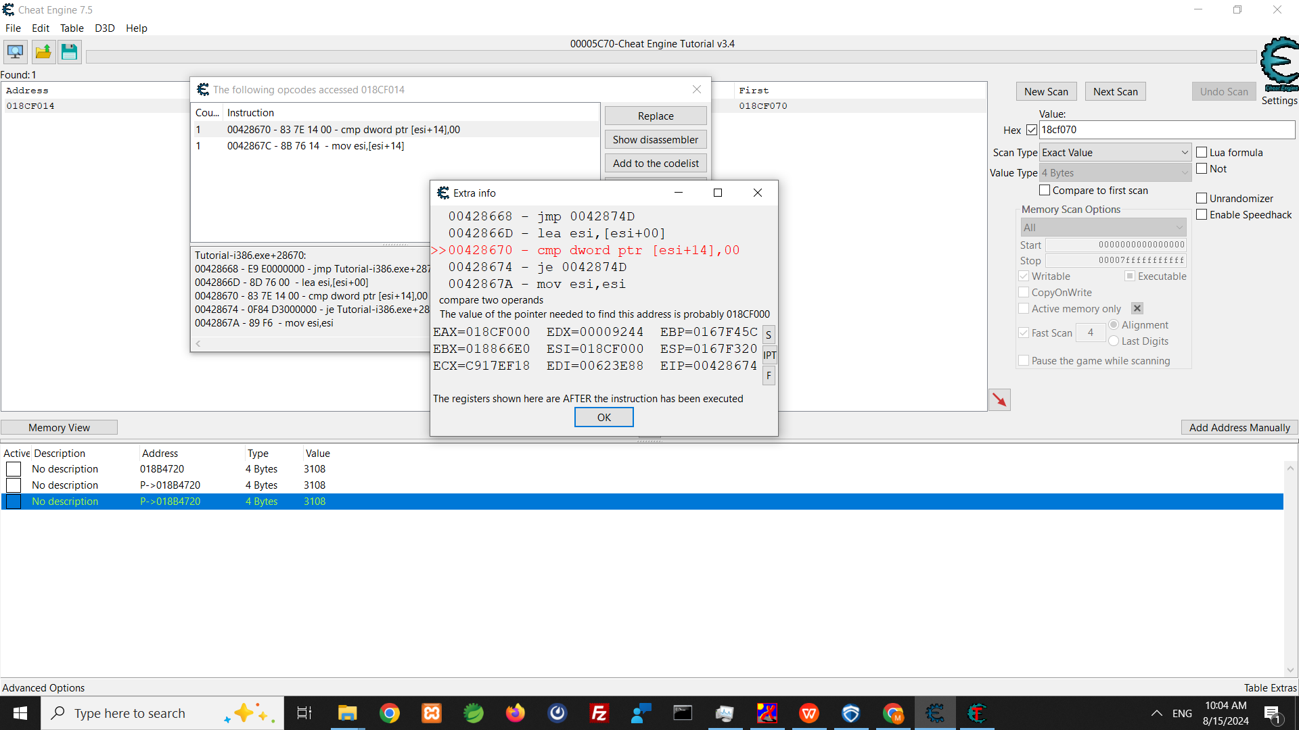

Slide 16
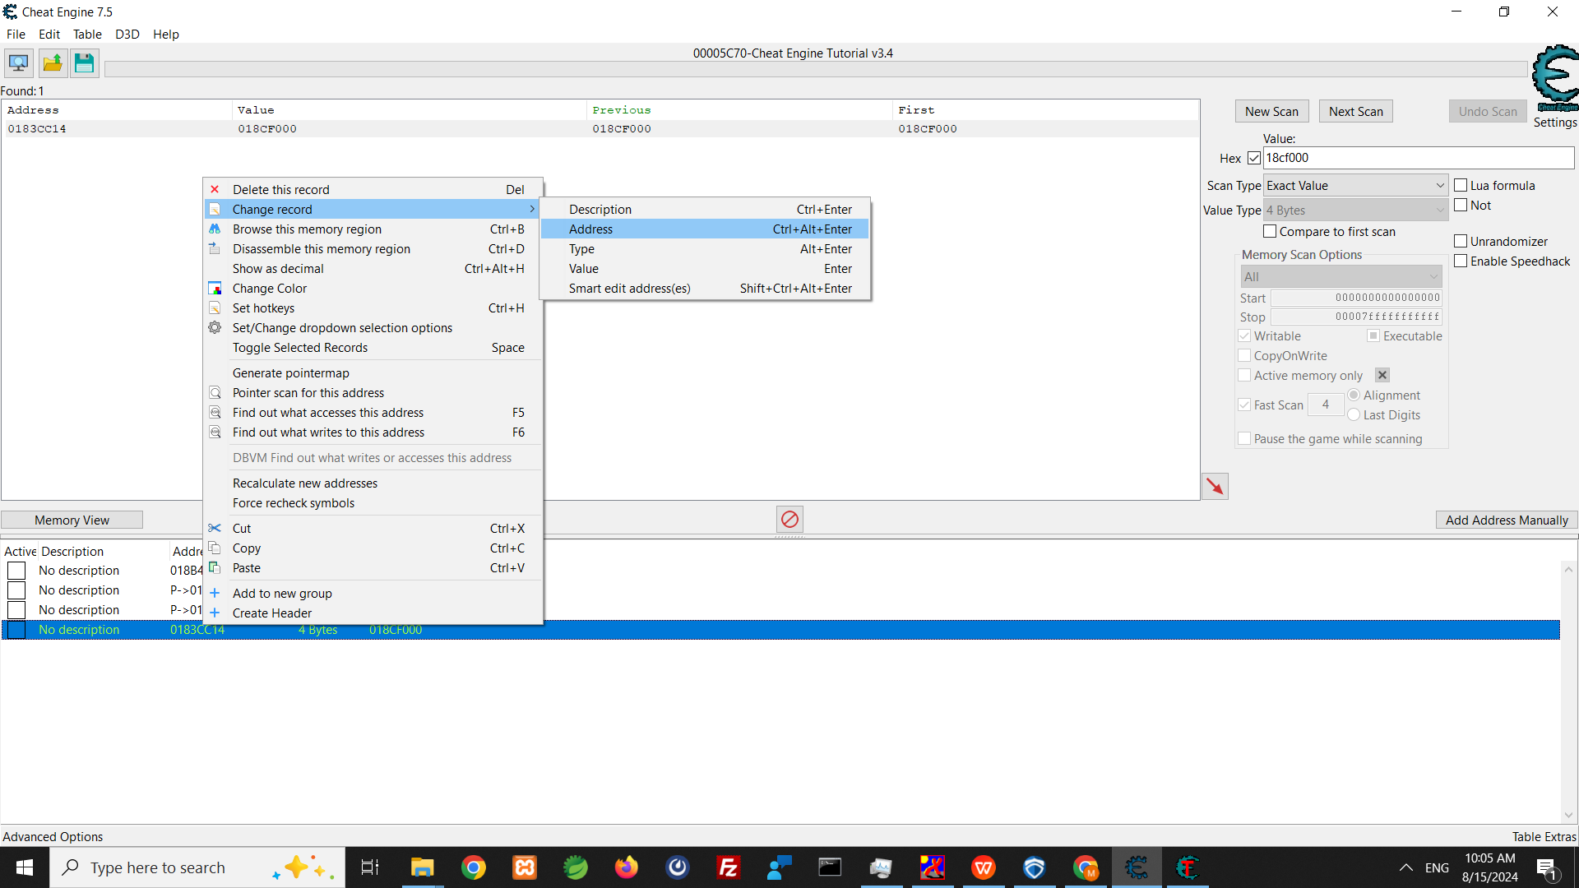

Slide 17
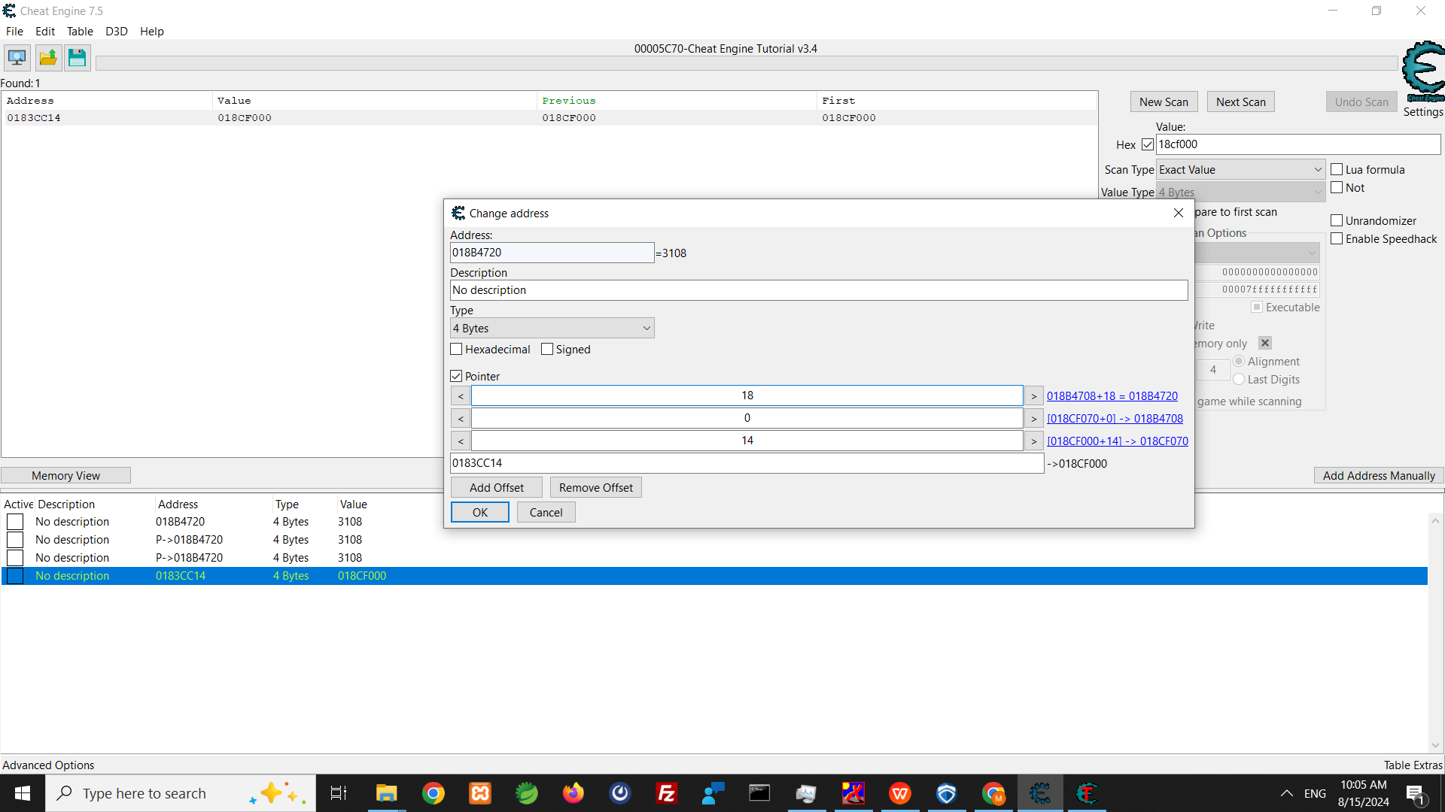

Slide 18
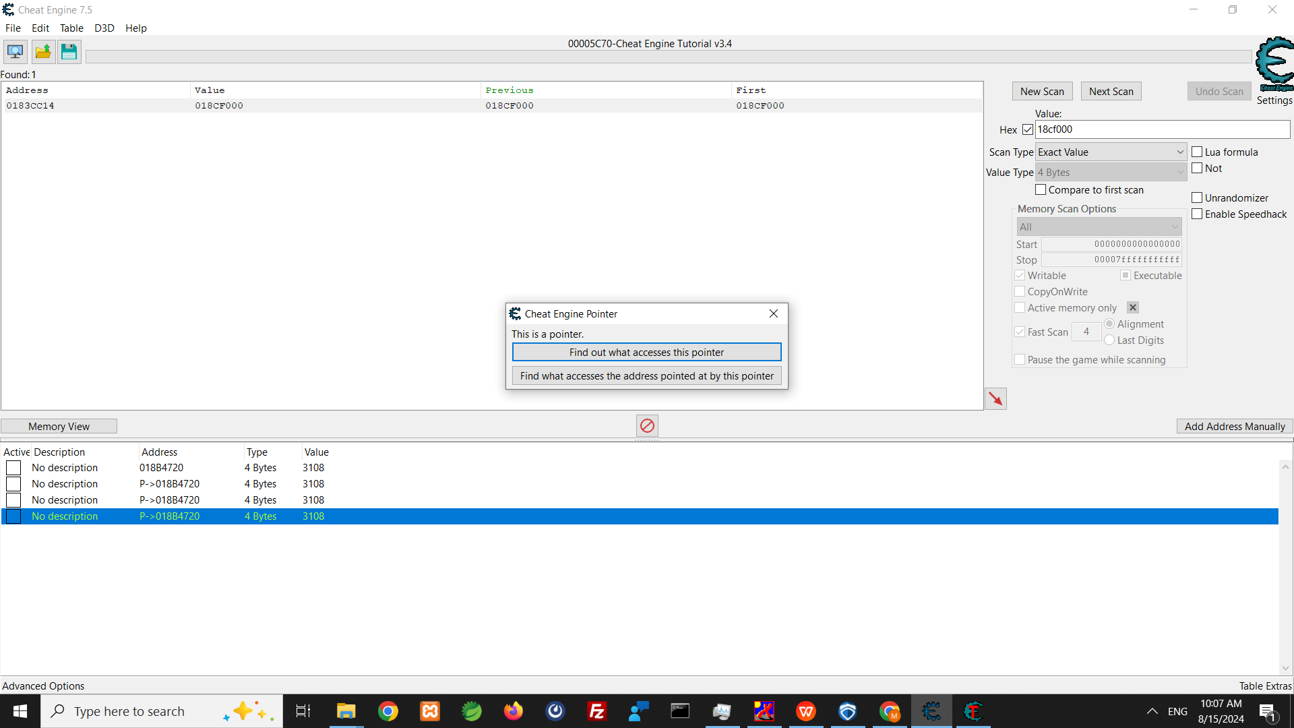

Slide 19
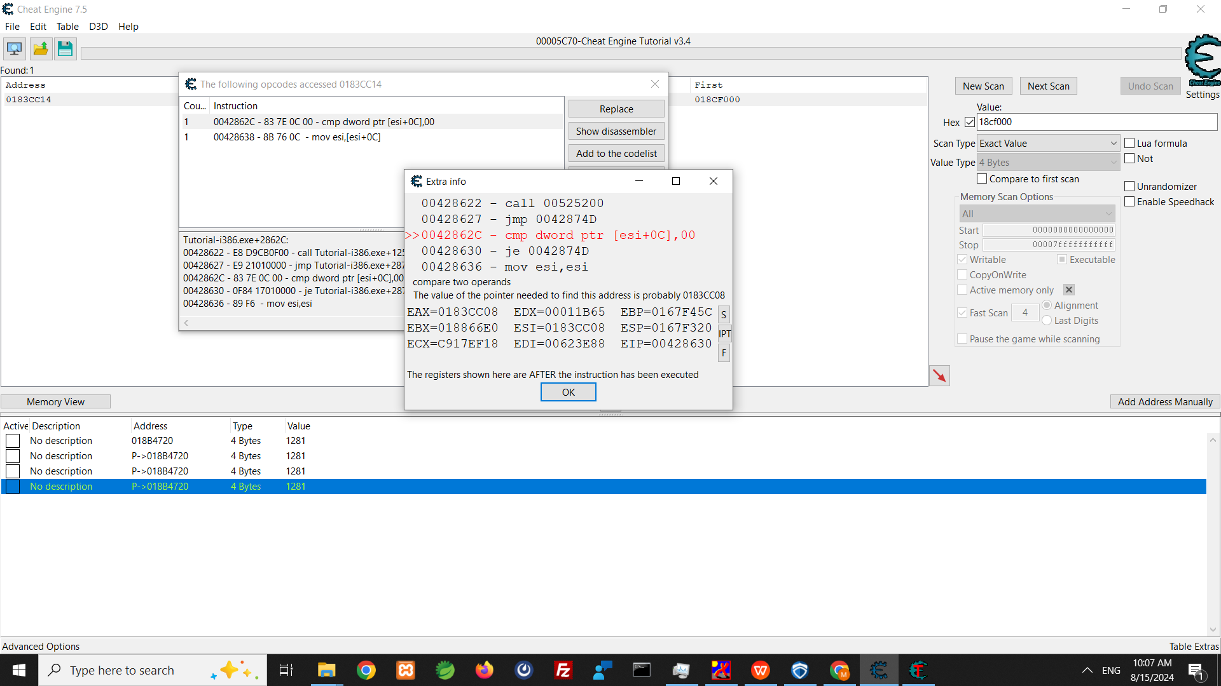

Slide 20
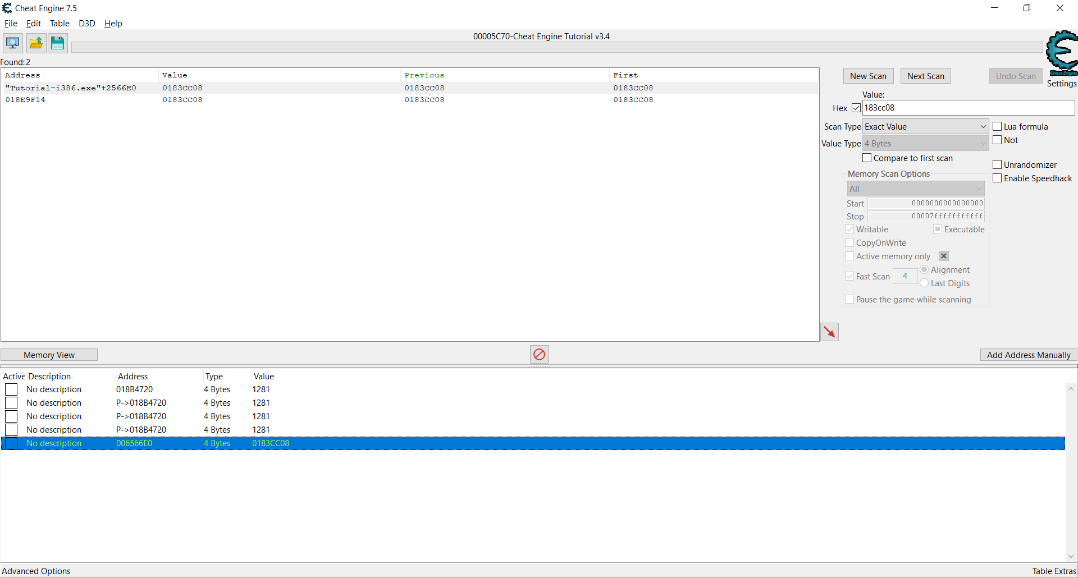

Slide 21
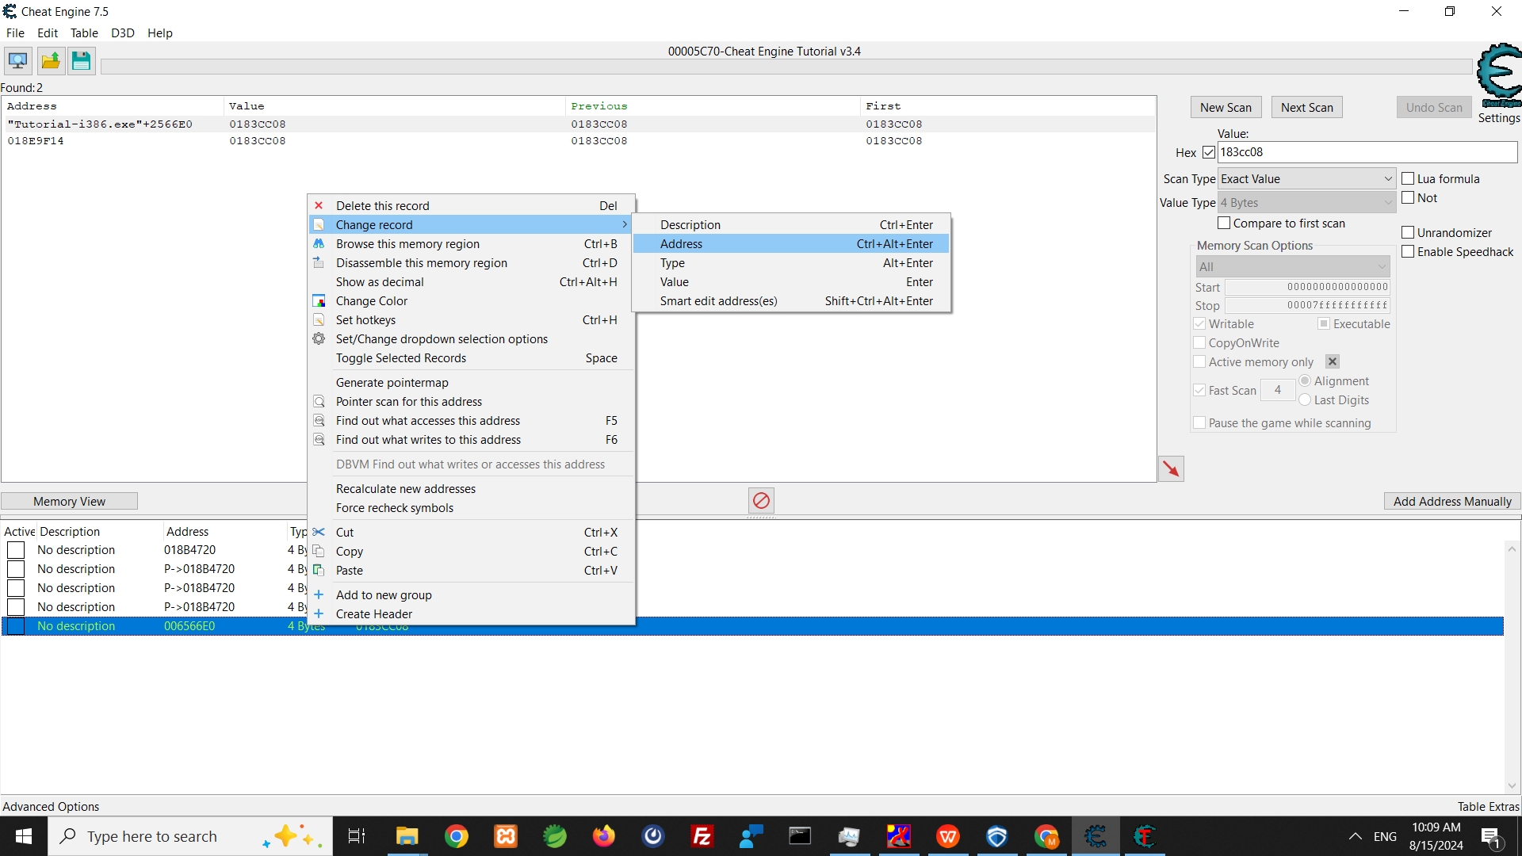

Slide 22
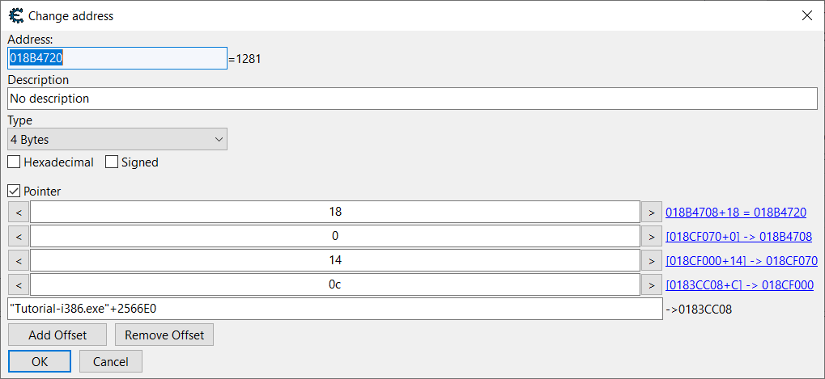

Slide 23
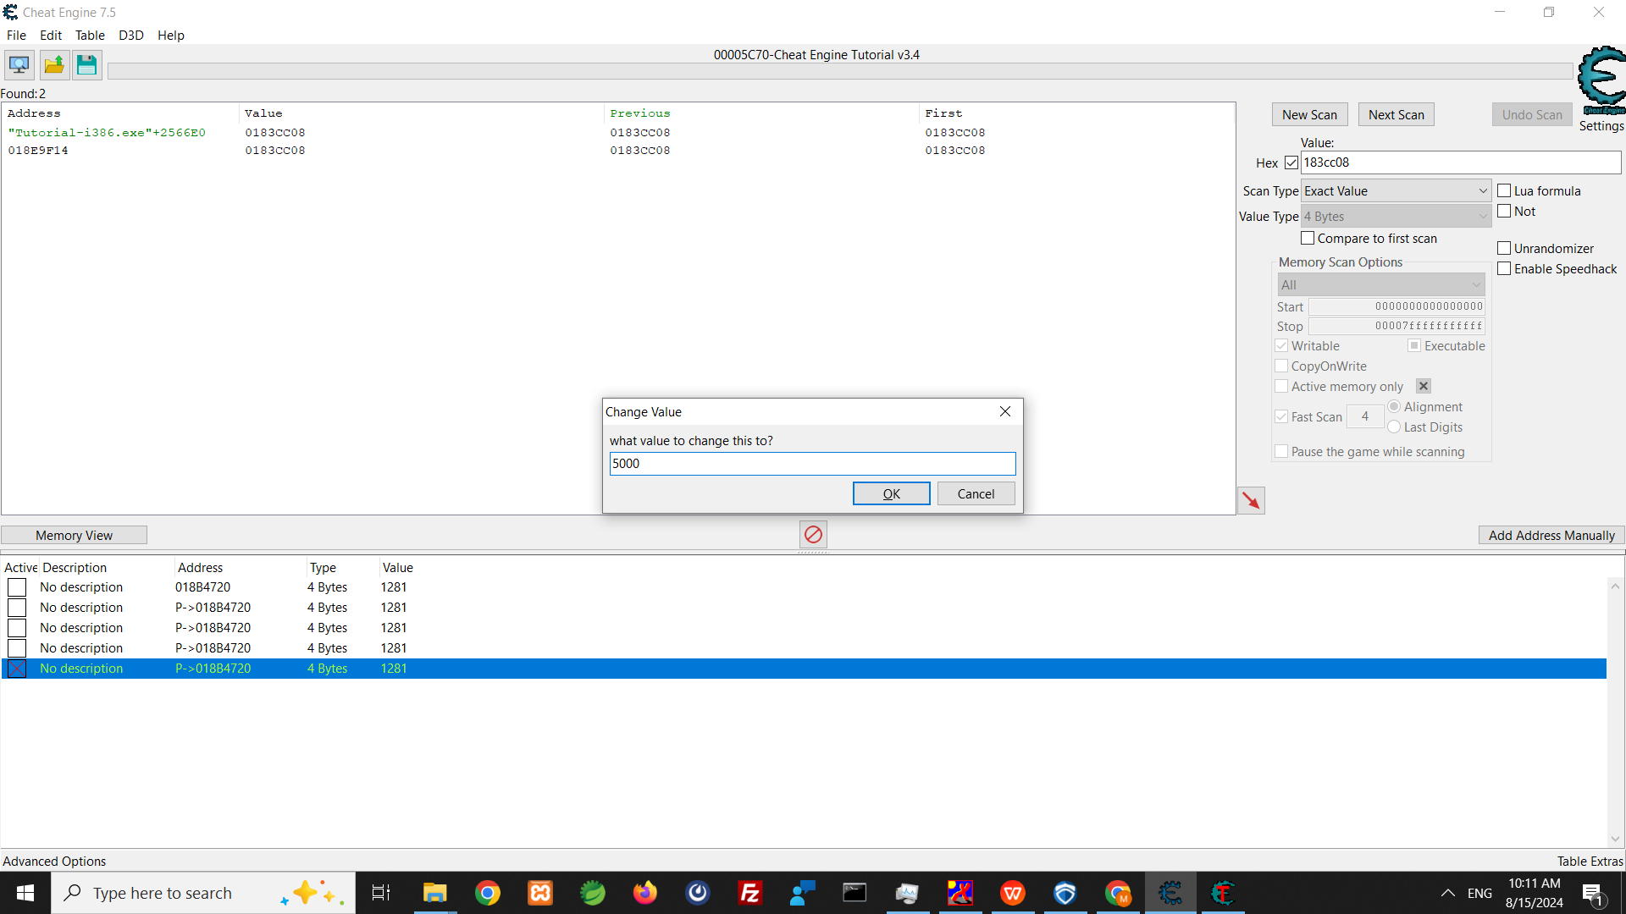

Slide 24
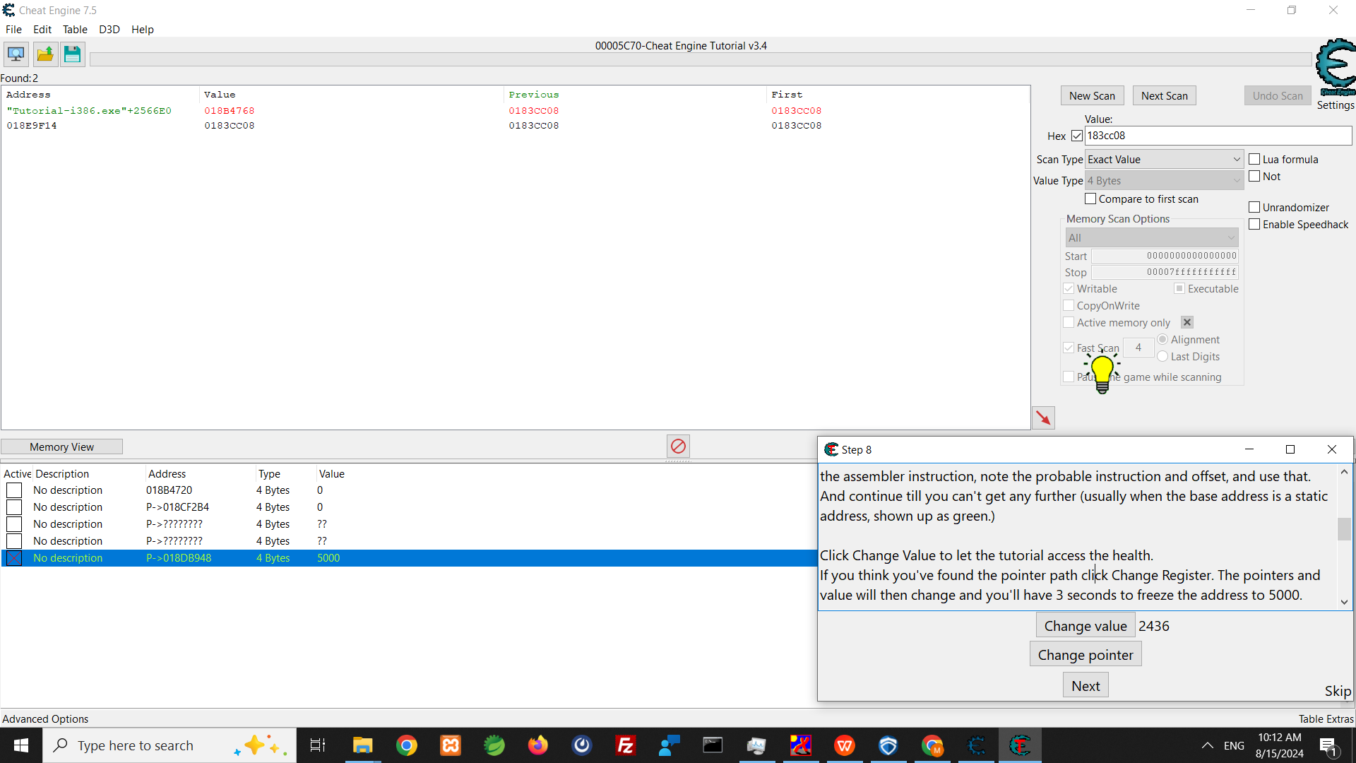

Slide 25
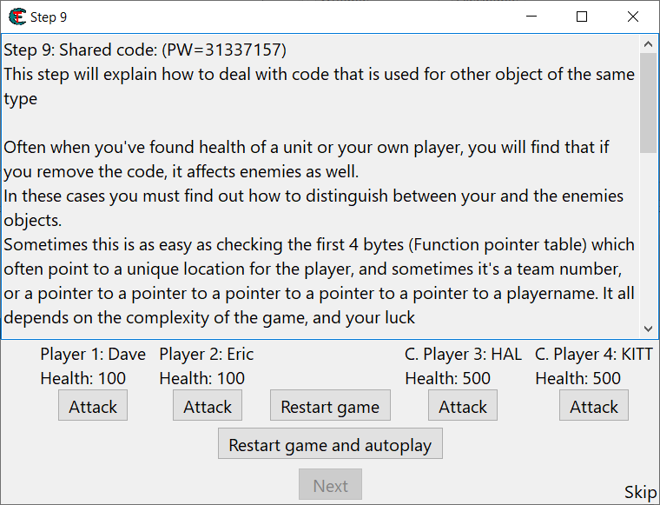
Step9

Slide 26
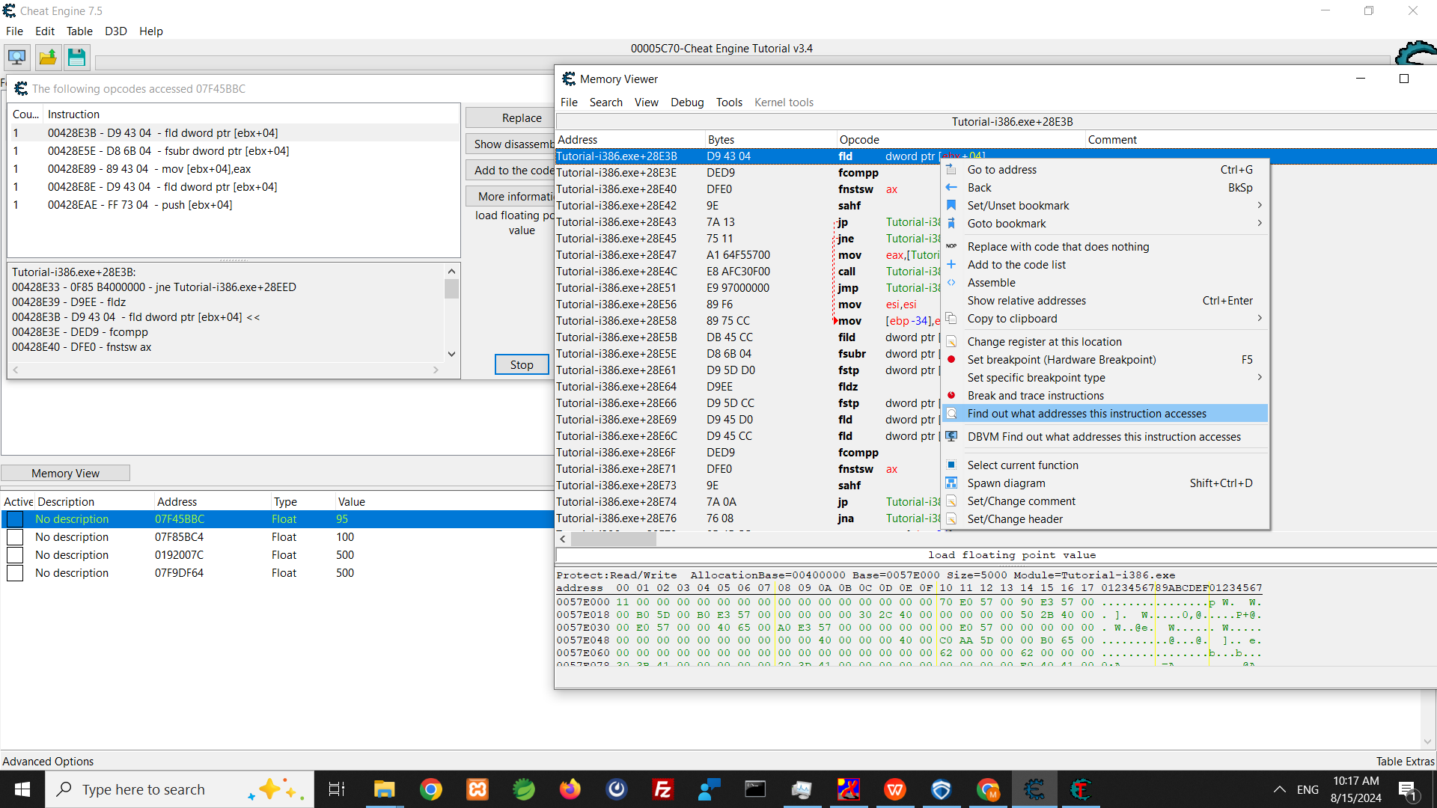

Slide 27
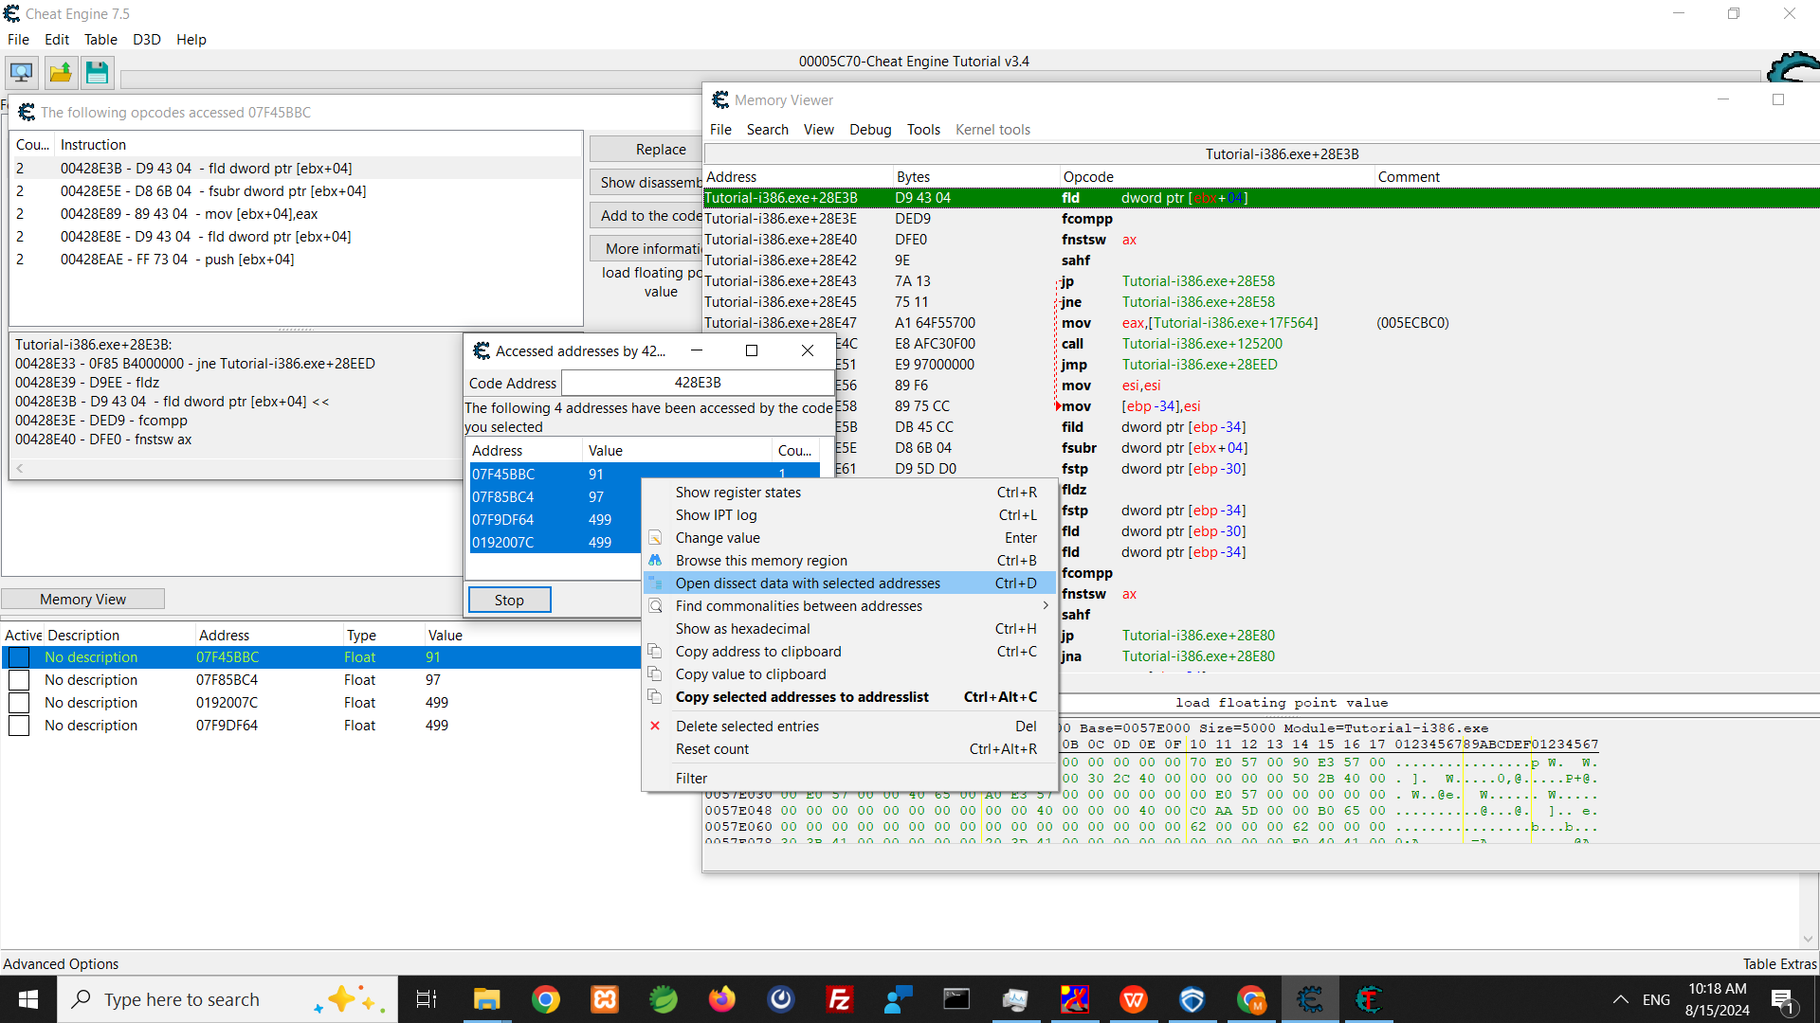

Slide 28
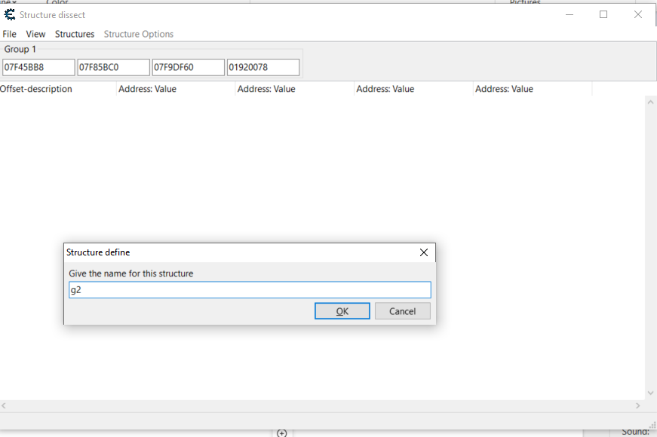

Slide 29
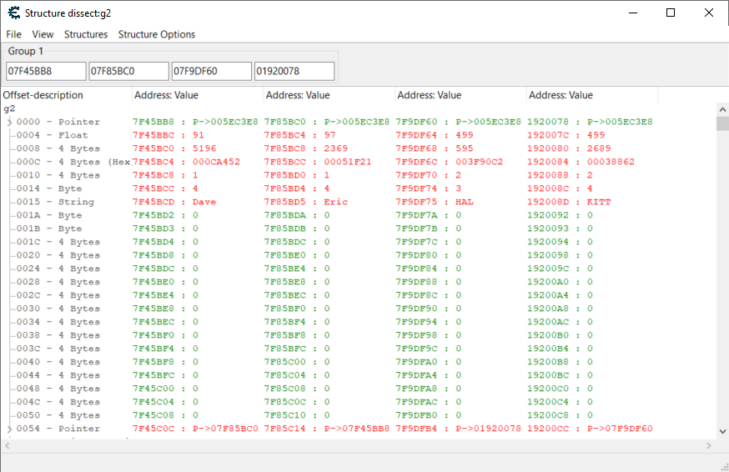

Slide 30
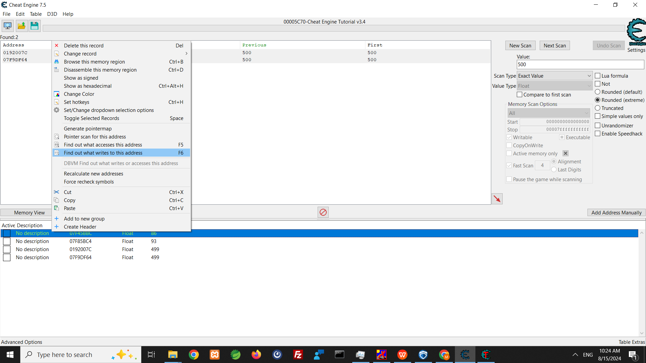

Slide 31
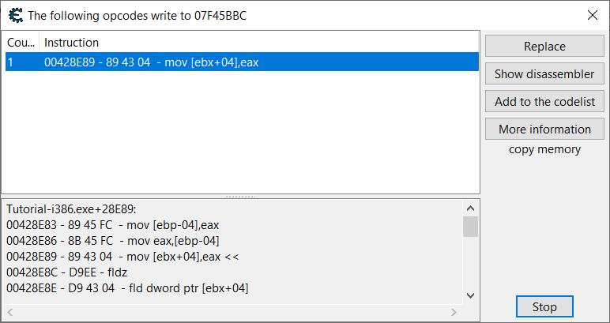

Slide 32
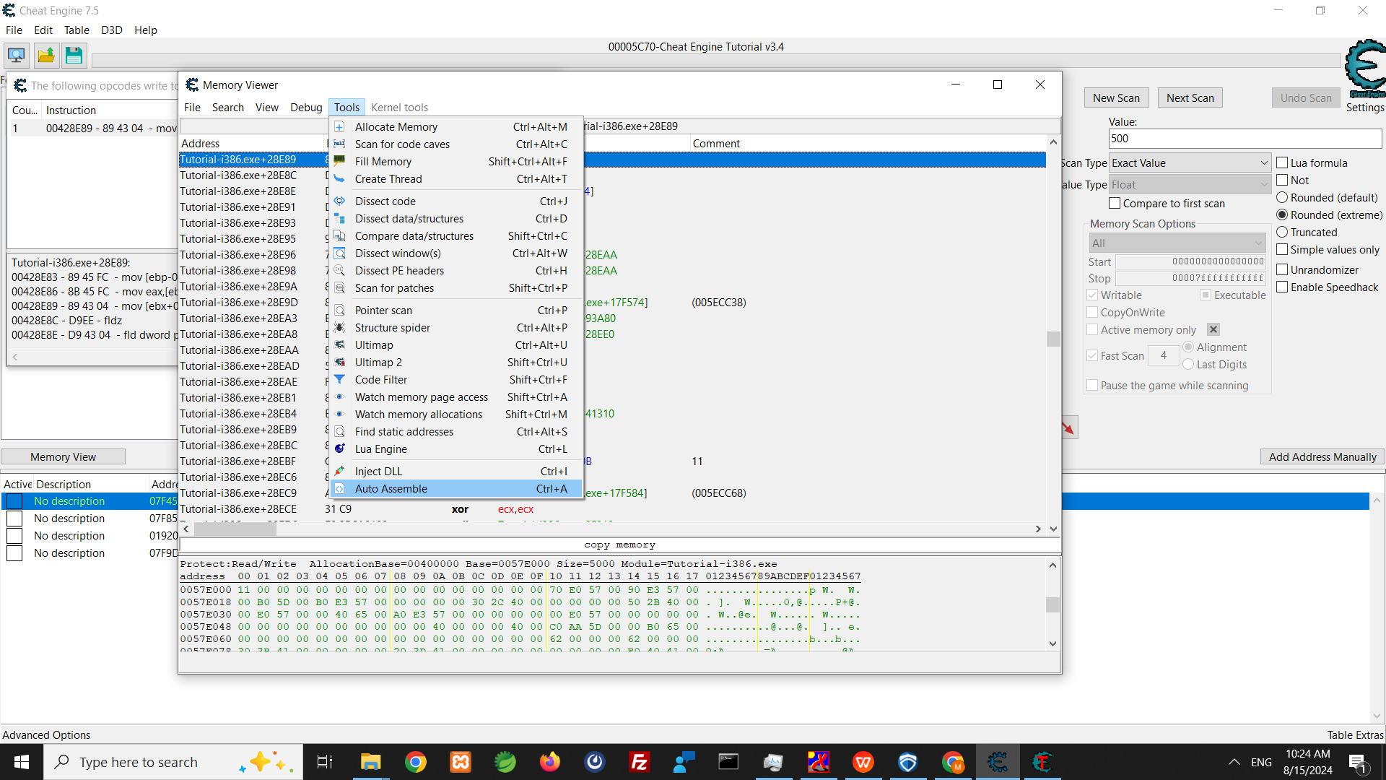

Slide 33
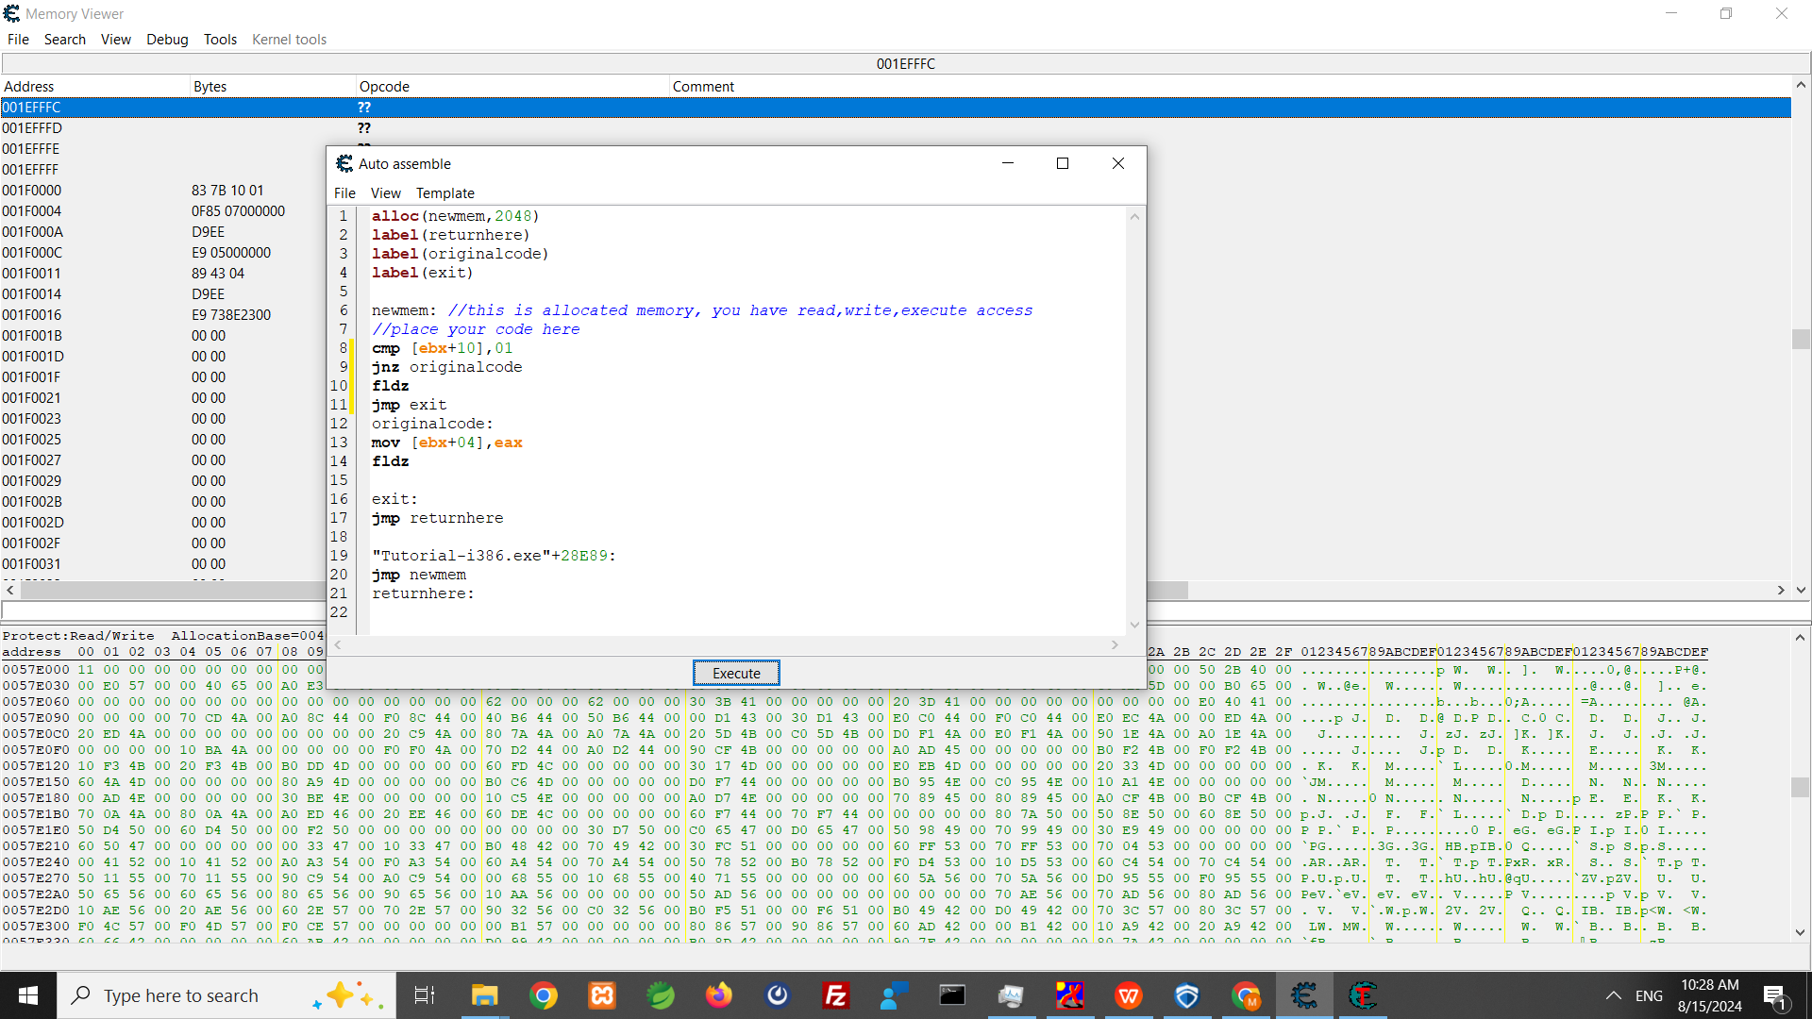

Slide 34
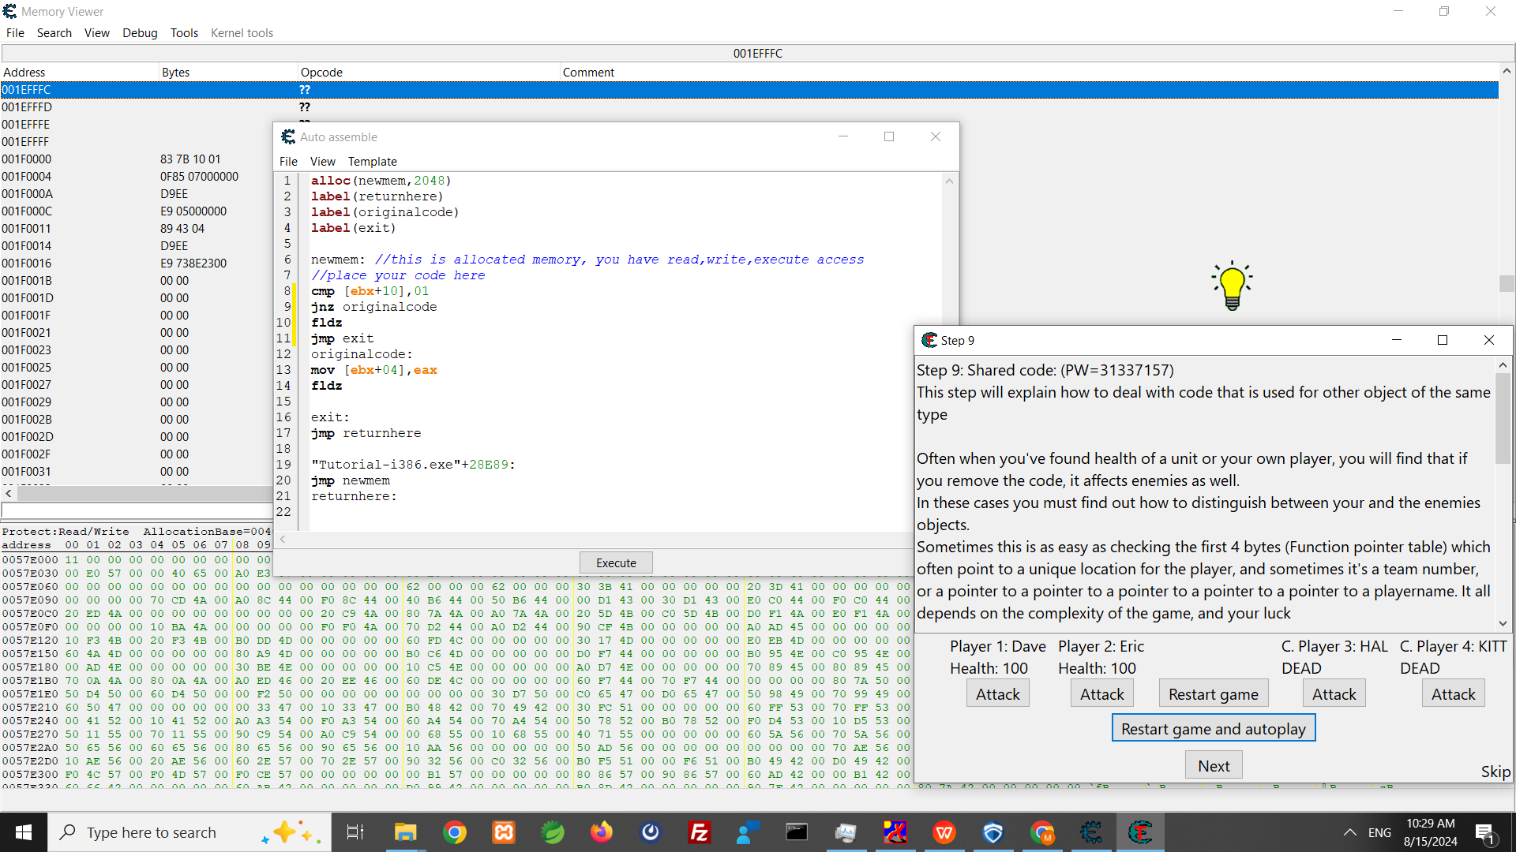

Slide 35
XMM registers
The 128-bit XMM registers are part of the SSE extension (where SSE is short for Streaming SIMD Extension, and SIMD, in turn, stands for single instruction multiple data). There are eight XMM registers available in non -64-bit modes and 16 XMM registers in long mode, which allow simultaneous operations on:
16 bytes
eight words
four double words
two quad words
four floats
two doubles

Slide 36
x86 instructs(1)
movss xmm3, [num1] ; Move 32-bit float num1 to the least significant element of xmm3
lea rax, [rbx+rcx*4]; compute rbx+rcx*4 and store it to rax
addss xmm0, xmm1 ; Add a single-precision float in xmm1 to xmm0
push rbp ; Save the old base pointer
mov rbp, rsp ; Set the new base pointer to the stack pointer
sub rsp, 0x20 ; Allocate 32 bytes on the stack for local variables

Slide 37
x86 instructs(2)
comiss xmm0, xmm1 ; Compare the scalar single-precision floats in xmm0 and xmm1
jp unordered_label ; Jump if unordered (NaN comparison)
jb less_label ; Jump if xmm0 is less than xmm1
je equal_label ; Jump if xmm0 is equal to xmm1

Slide 38
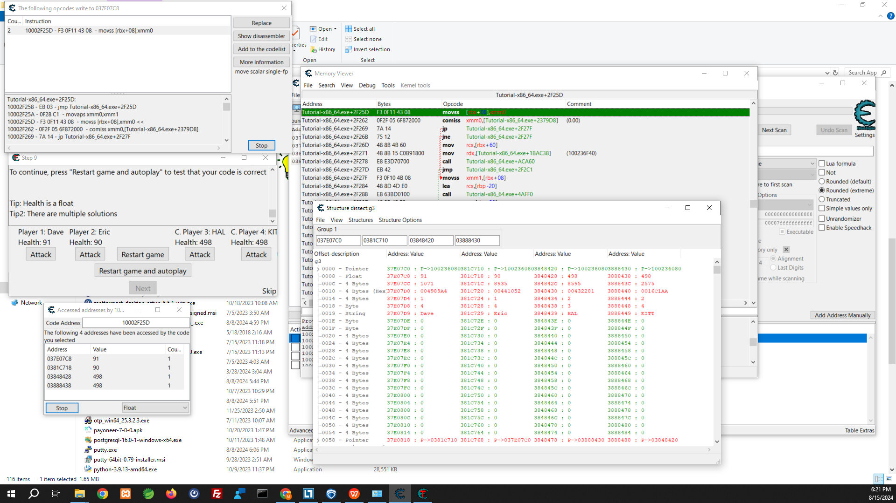

Slide 39
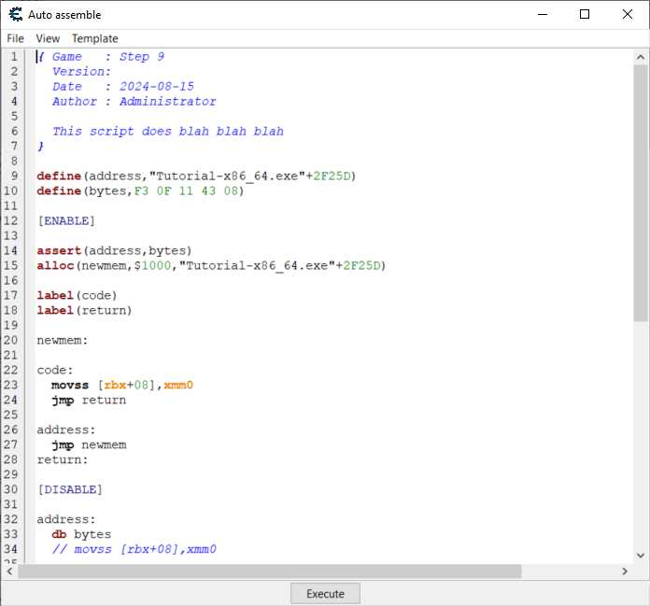

Slide 40
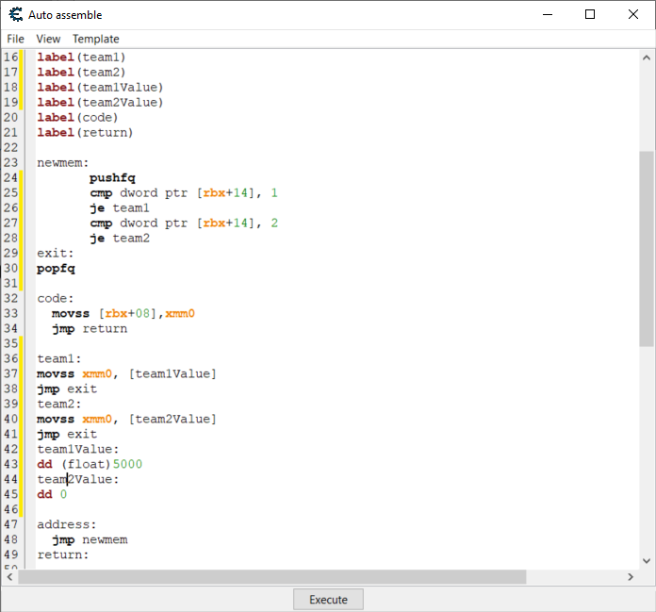

Slide 41
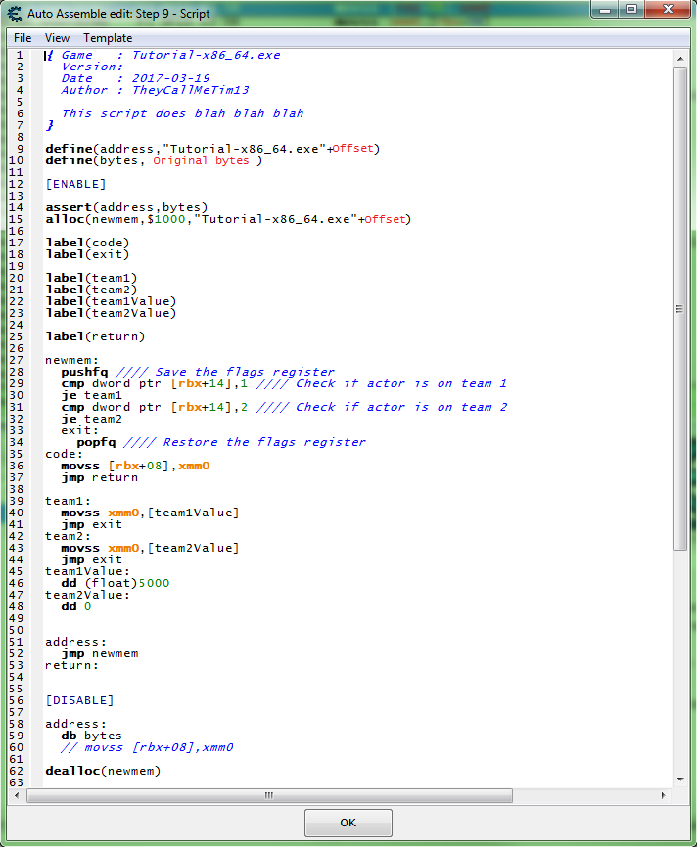

Slide 42
